Slide 1

LBD-CG presentation
Compliance checking for construction project data with linked data
Marin Ljuban

Slide 2
Introduction
The goal is to asess how IFC could be lifted to a more generic ontology, enabling connection of BIM models to other information models such as GIS, Electronic Document Management (EDM), Systems Engineering (SE), Monitoring & Control (M&C)… The planned process can be summed up in 3 main steps:
TASK
TASK
Creation of the object type library (OTL) from the IfcOWL and XML Property Set files and connecting it to the new EN ontology
Development of script that parses IFC-STEP file and produces an OTL-compliant dataset
Creating SHACL ruleset to enable dataset checking based on local, national or EU regulation
When parsing the actual IFC file, the IFC relations considered in the scope of the thesis (spatial containment & decomposition) will be replaced with equivalent concepts from the new EN ontology.
The IFC properties are not available directly in the IfcOWL, but in XML. The properties will be converted to RDF with the help of RML and appended to the OTL classes aligned to the EN 17623.
The existing IfcOWL ontology will be queried for classes and used as a base for creation of classes of the new OTL and connected to the ISO 17632 ontology
The IfcOWL ontology will be queried for attributes of classes queried in step 1. These attributes will be appended to newly created classes but aligned to the EN 17632.
SCOPE
Taxonomy
Relations
Attributes
Properties

Slide 3





State of the art in digital building permitting
The building design process Is complex and fragmented, with 10 to 12 disciplines involved on average – manual compliance checking with low accuracy and high cost
Only 27% of economies use a digitized e-submission based process, OECD leading with 48%
ACC researched for over 50 years, with significant uptake in the last 7 years – connected with the increase of adoption of digital representation of building and geospatial data across the world
Complex and multi-factored problem; technical and non-technical factors- this research deals with technical part
Rule interpretation & digitalization
Preparation of 3D city models and geo info
Pre-consultation & preliminary analysis
Notable efforts in the European Union
BIM modelling & IFC export
Application review (formal)
Conversion 3D city model/geo info
Relevant findings
Application review (content)
Academic research is steadily growing since 2015 – pilot deployment gained momentum in 2022
Technological solutions should be based on the open standards and easy to use
Despite alignment efforts, there is little chance for one-fits-all solution; for mass deployment flexibility and customization is key
Completion & notification
Eight step framework for digital permitting (Noardo et al., 2022)

Slide 4
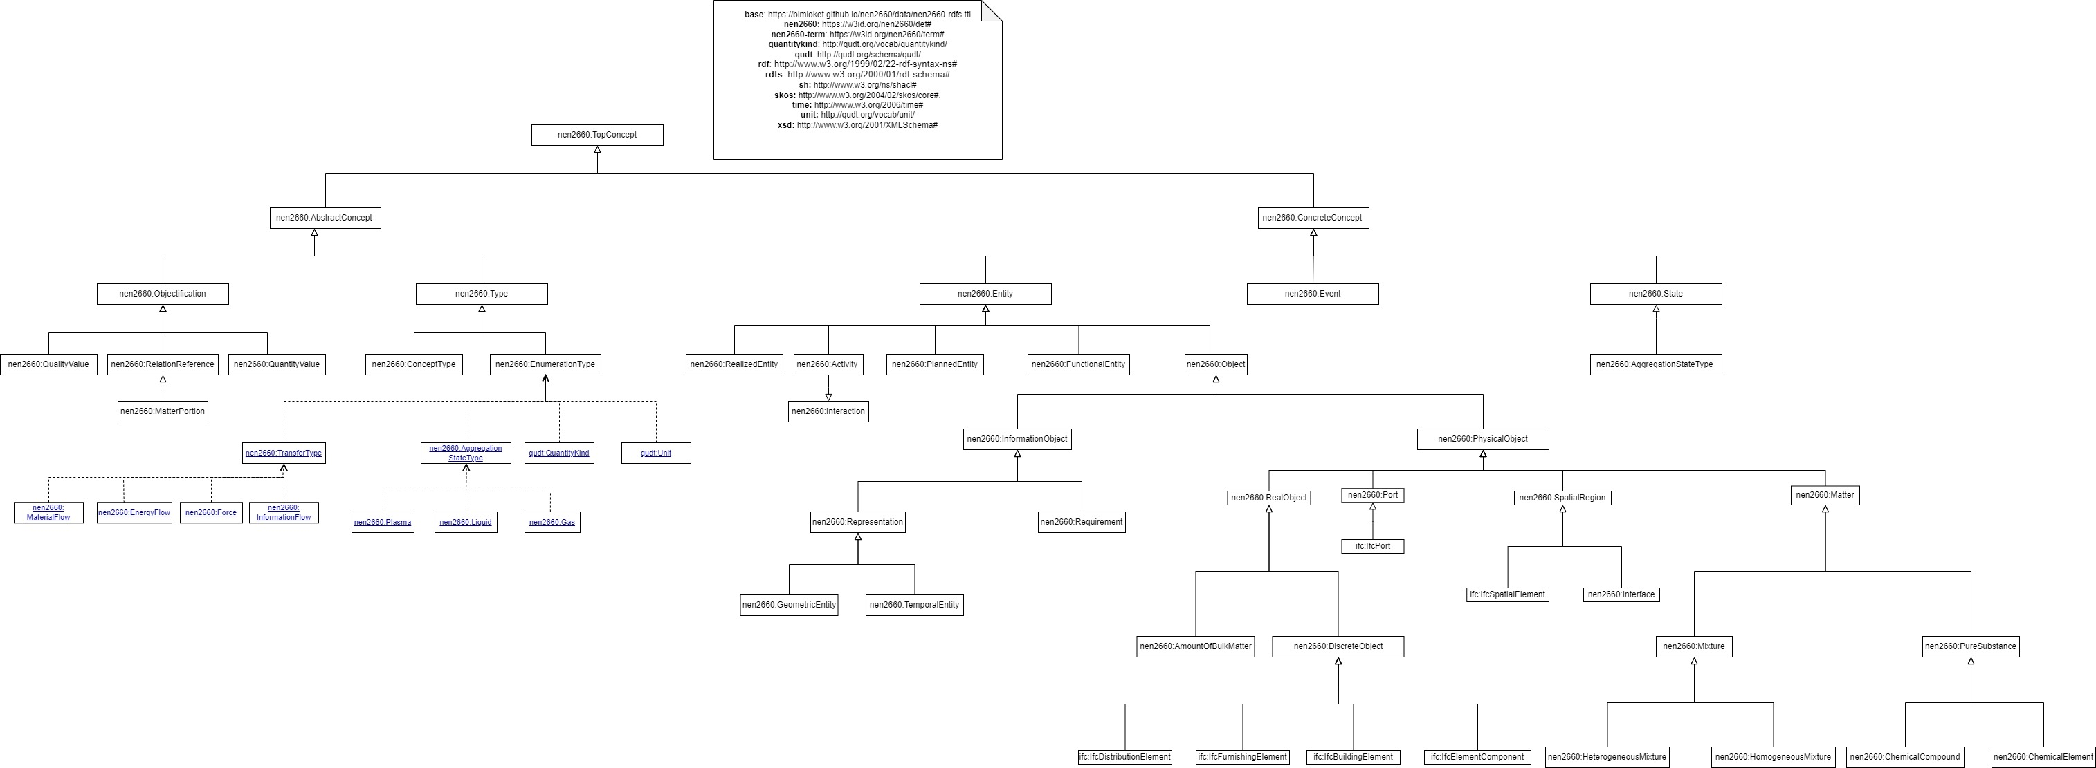
EN 17632, BIM – Semantic modelling and linking (SML)
Newly published (March 31st) standard enabling more efficient management of projects and the resulting assets. The document specifies how organizations in the built environment should apply Linked Data to best suit their needs. The application should help integration of complex information models (BIM, GIS, EDM etc.)
Contains a generic construction ontology, as well as guidelines about modelling patterns and application of levels of semantic modeling capability for different use cases (vocabulary, basic/advanced ontology)
At the time of beginning of the research the EN 17632 ontologies were not available. Therefore, the dutch predecessor (nen2660) is used. It is believed that the EN ontology would only contain minor difference from the nen2660.
Focus on building elements, properties (attributes) and relations. Possible to express additional relationships e.g. materials (nen2660:matter) and system connections (nen2660:Port)
Guidelines. Easy to implement.

Slide 5
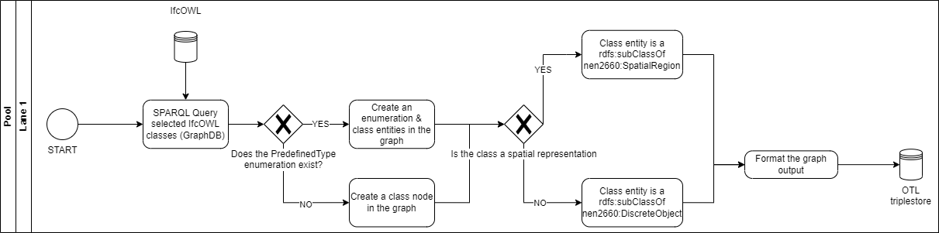


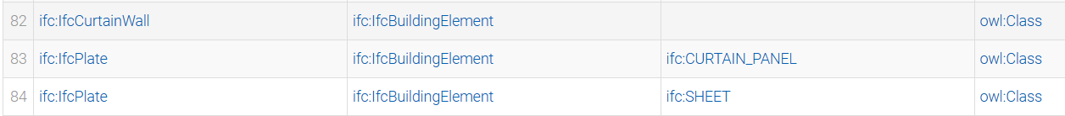
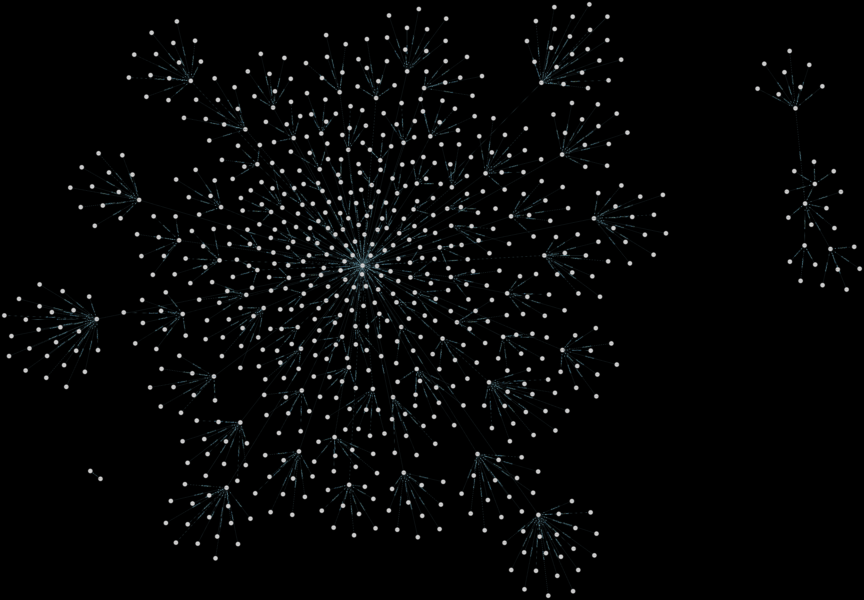
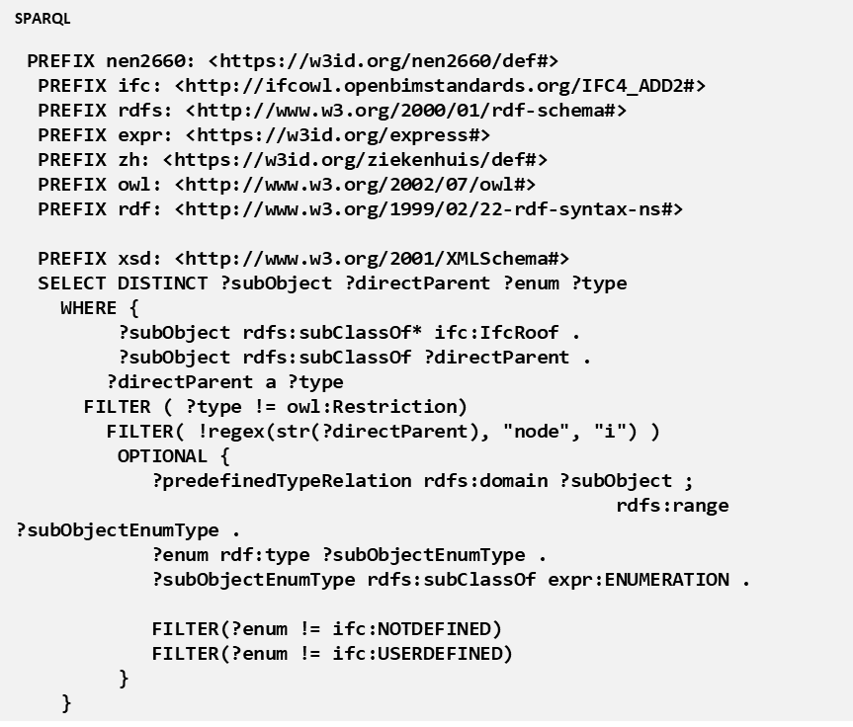
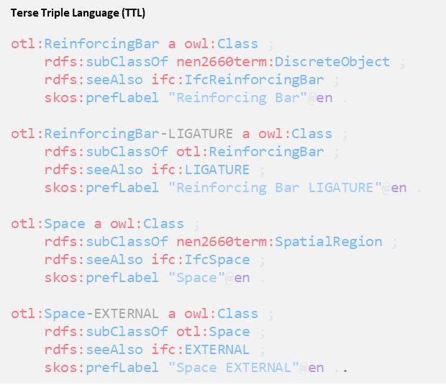
OTL Taxonomy

Slide 6
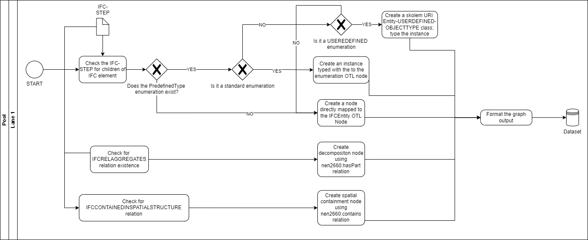

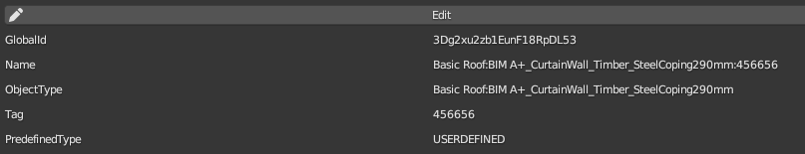
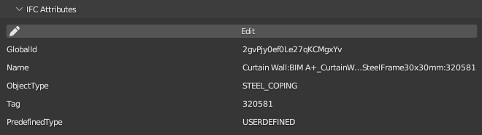
Parsing IFC-STEP

Slide 7
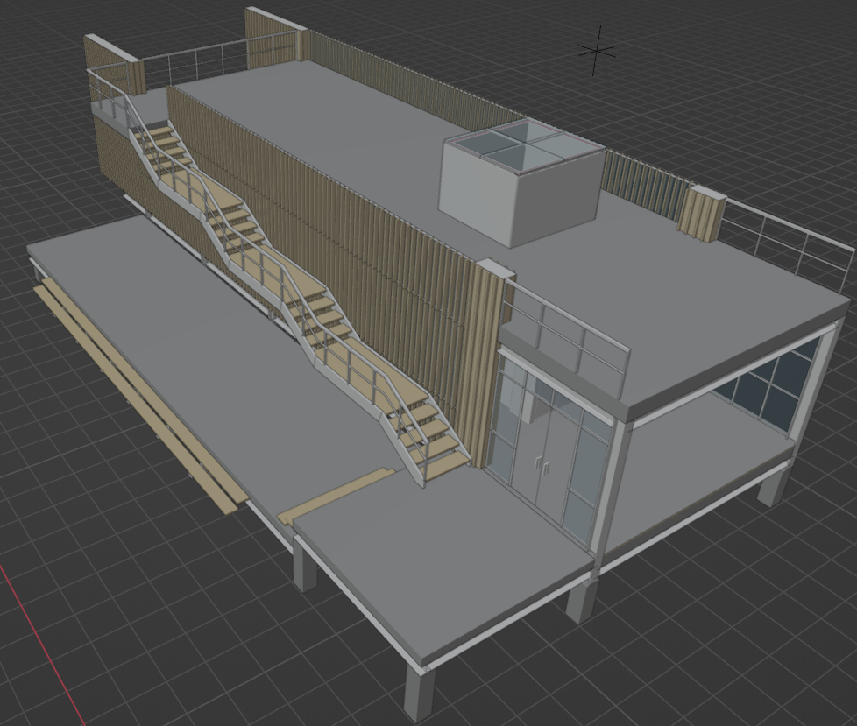
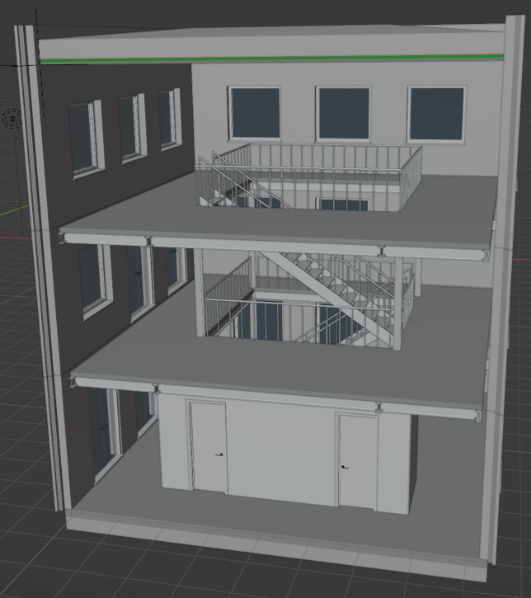
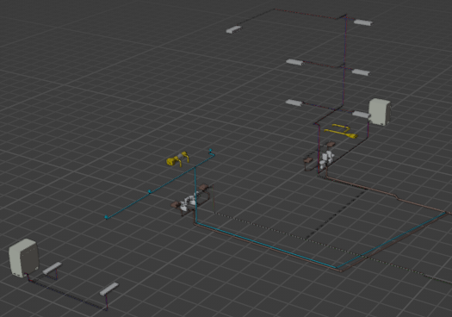
Test projects

Slide 8
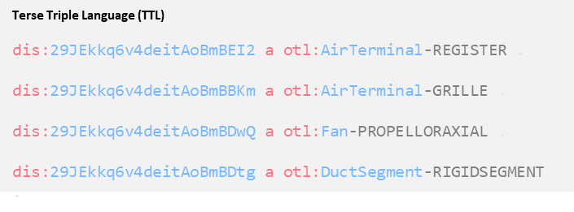
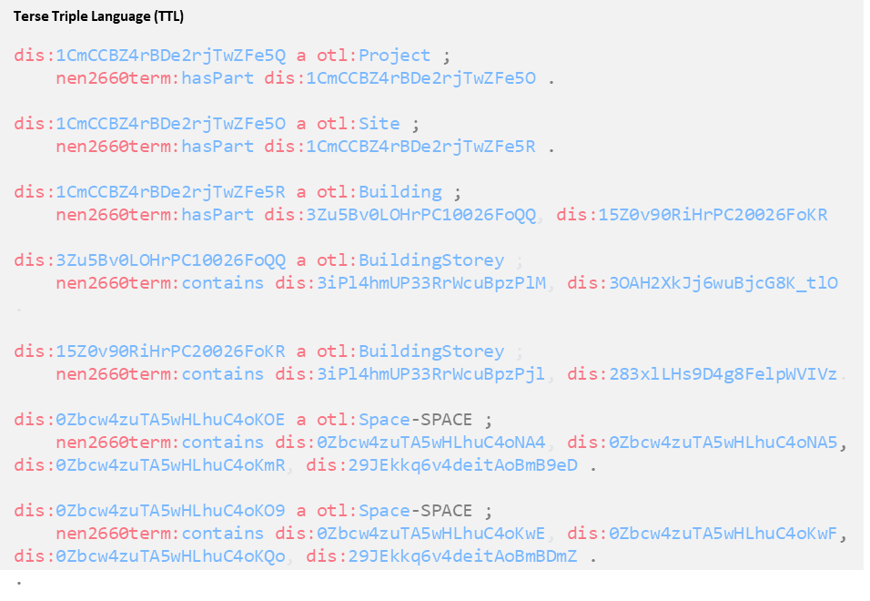
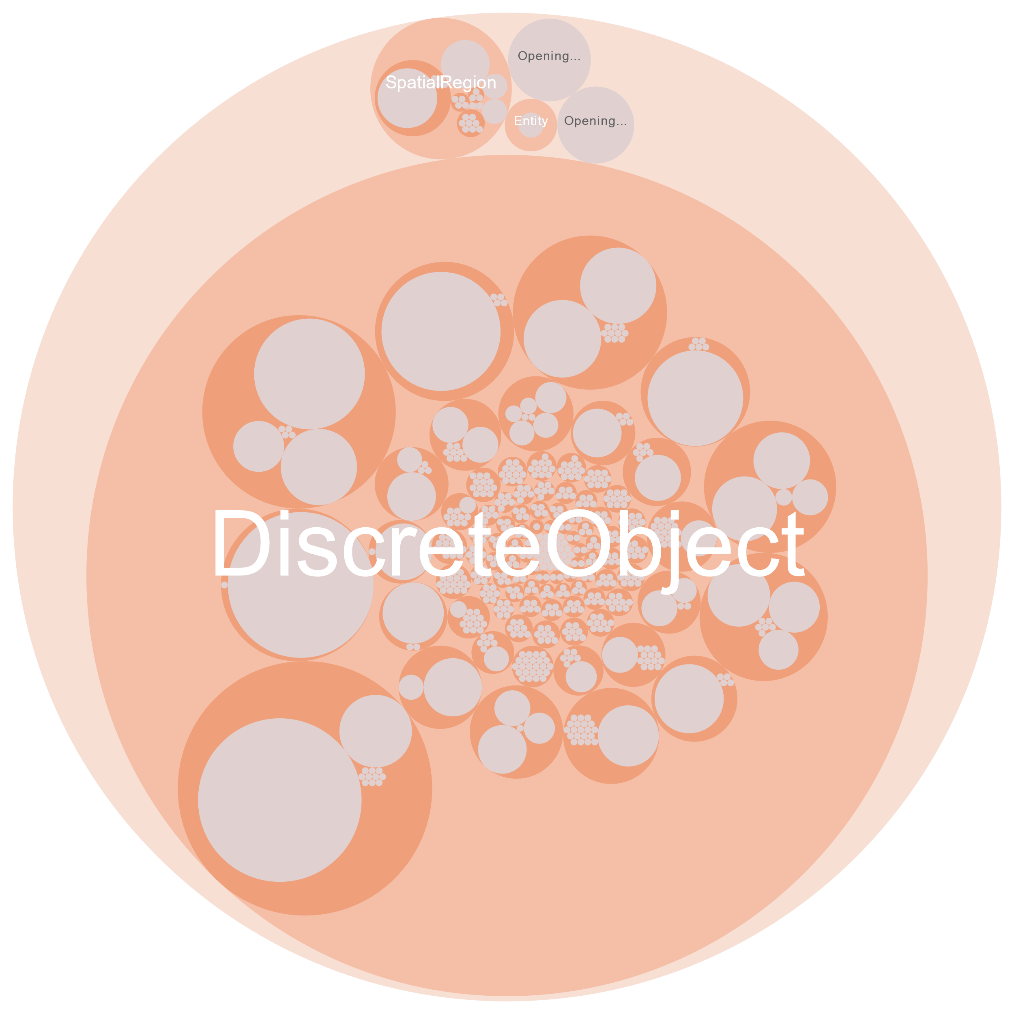
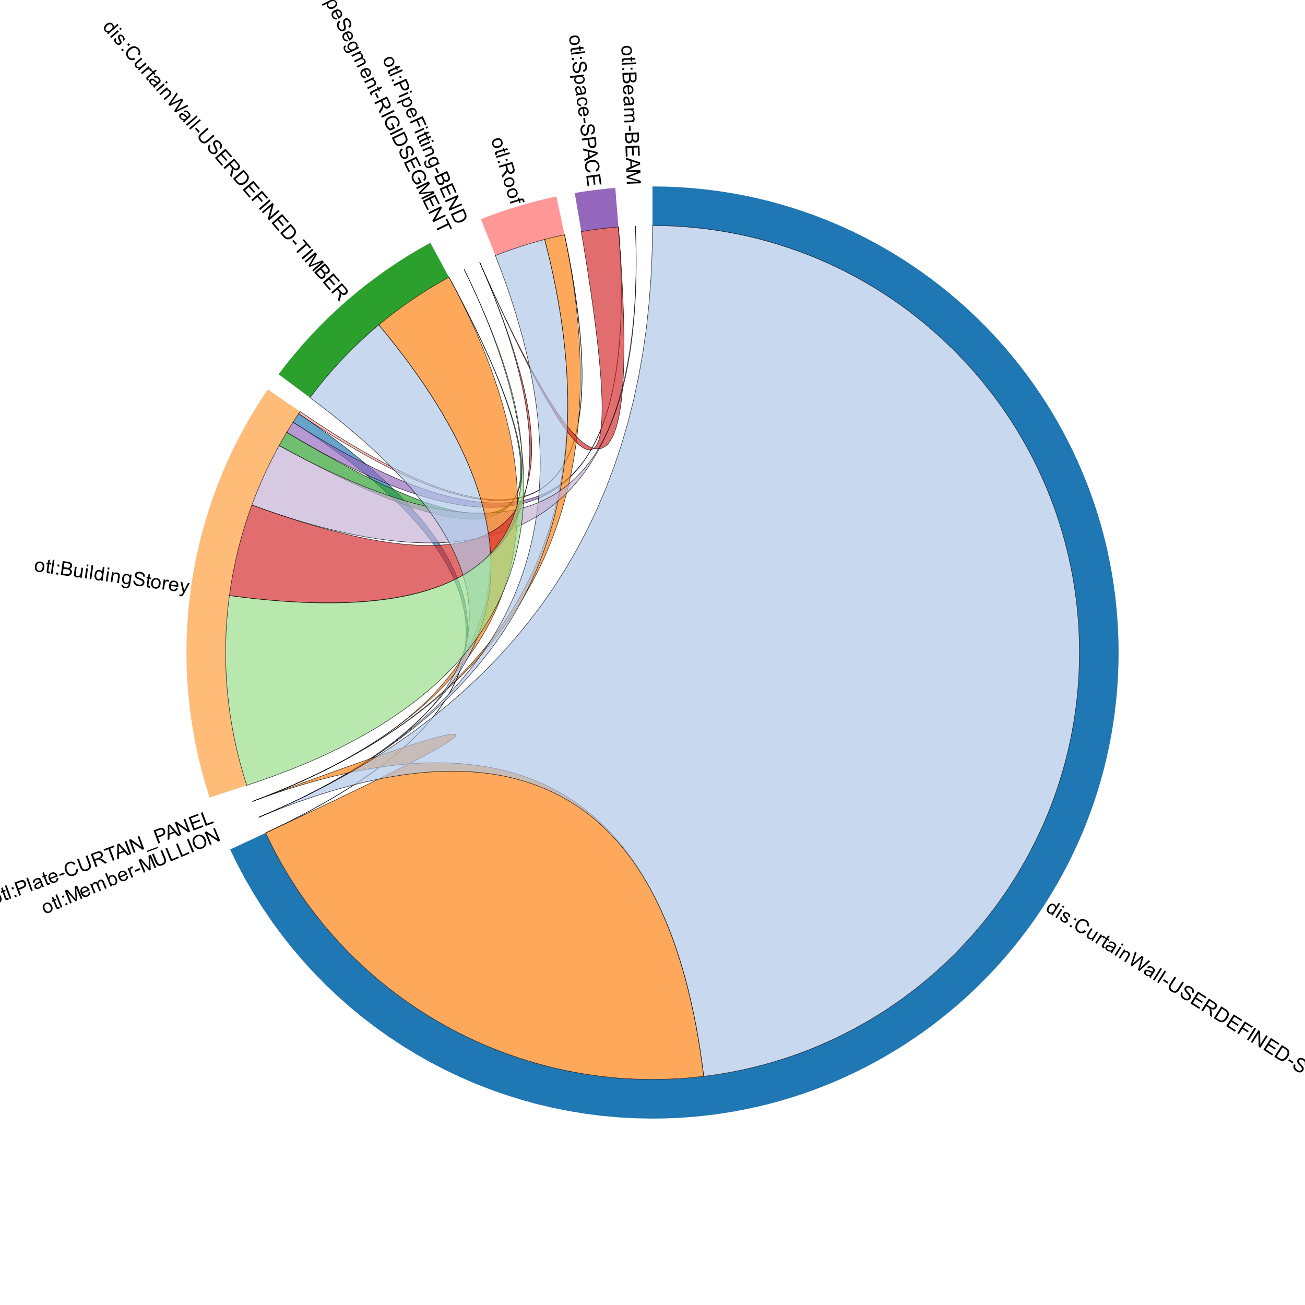
IFC-STEP Validation
File name | Number of entities in the LBD dataset | Number of entities in the thesis dataset
Arch1 | 2740 | 2741
Arch2 | 251 | 252
Mech | 492 | 493

Slide 9
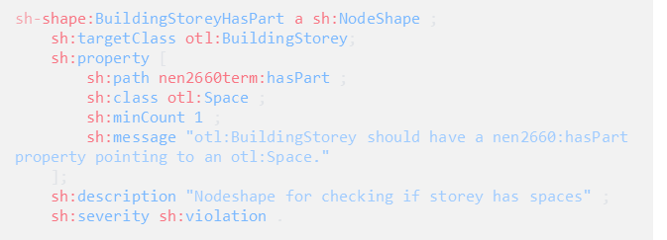
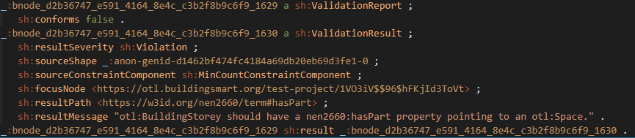
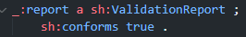
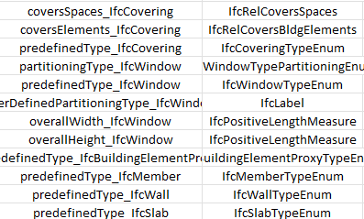
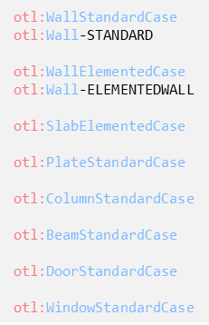
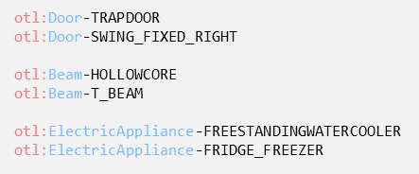
SHACL & To be done
Expressing IFC attributes with the QUDT units (prescribed in EN 17632); parsing of the IFC attributes
Conversion of IFC properties contained in XML Property sets to OWL (RML); parsing of the properties, both predefined as well as user-defined properties
Creation of SHACL shapes to validate some of the entities for compliance with regulations – testing of different available tools, e.g. RASE Markup, NLP processing for automation of SHACL shapes
Remarks about the IFC structure
Relevancy of attributes, properties and the units – aligning with QUDT
Standard & Elemented case as enumeration or as entity?
Consistency in enumeration naming needed
How to map same spatial entities from different models of the same project (e.g. architectural & MEP)

Slide 10
Thank you for the attention!
Questions?

